Slide 1



Education’s Impact on various Developmental Factors across multiple countries

Slide 2
TABLE OF CONTENTS
01 PROBLEM STATEMENT & INTRODUCTION
Problem Statement
Introduction- Theme: Education
02 RESEARCH BACKGROUND
Categories: Why are they important/ relevant?
Economy
Social Development
Health
03 PROPOSED RESEARCH METHODOLOGY
Data Source & Time Period
Grouping Variable
Variables
Hypothesis Testing
Summarized Key Results
04 SCOPE AND LIMITATIONS
05 CONCLUSIONS AND FUTURE RESEARCH

Slide 3
01
PROBLEM STATEMENT & INTRODUCTION

Slide 4
PROBLEM STATEMENT
To analyze how Education influences the Economy, Social Development , and Health across countries throughout the five continents of North America, South America, Asia, Africa and Europe.
To study the Economy, Social Development, and Health and examine if they impact each other.

Slide 5
THEME: EDUCATION
All people have a right to education. It is vital to future development, accomplishments and success.
Children and youth gain necessary knowledge and skills through quality basic education.
It also reduces rates of poverty and promotes economic growth and social development. (Habitat for Humanity of Broward, 2020)

Slide 6
THEME: EDUCATION
Having an educated population leads to:
Economic development and growth. (Bansal, 2020)
More allocative and productive efficiency; which leads to rapid rates of development across multiple sectors. Example: Health, agriculture, public administration, private sector growth, etc. (Radcliffe, 2020)
For a country to fully reap such benefits, they need to unleash the potential of the human mind:
There is no better tool to achieve this than education (The World Bank, 2021).

Slide 7
THEME: EDUCATION
People with more education: Live longer, healthier lives than those with fewer years of schooling.
Families with higher incomes can easily purchase healthy foods, have time to exercise regularly, and pay for health services and transportation.
An additional four years of education lowers five-year mortality, reduces the risk of heart diseases and diabetes. (Picker, 2007)

Slide 8
02
RESEARCH BACKGROUND

Slide 9
CATEGORIES
Why are they important/ relevant?

Slide 10
Category: ECONOMY
An economy is the system according to which the money, industry and trade of a country or region are organized. (Collins, 2020)
Education is a leading determinant of a country’s economic growth, employment and earnings. (Grant, 2017)
For every US $1 spent on education, as much as US $10 to US $15 can be generated in economic growth. (UNESCO, 2011)
An additional year of schooling can increase a person’s earnings by 10% and average GDP by 0.37%. (Hanushek et al., 2008)

Slide 11
Category: SOCIAL DEVELOPMENT
Social Development aims to improve the well-being of every individual in society so that they can reach their full potential. (New Brunswick Canada, 2008 - 2009)
Education is an essential tool for social development.
It contributes to the improvement of the human condition through better knowledge and awareness across multiple areas such as health, living conditions, social equity and productivity, etc; which in turn results in a more socially sustainable environment. (Spiel, 2018)
People often use education to form their social identity, outlining their relationship with others and while outlining their understanding of themselves. (Manstead, 2014)
People with low levels of education have a harder time developing a positive social identity; which can negatively affect self-esteem and wellbeing. (Manstead, 2014)

Slide 12
Category: HEALTH
A healthcare system can be defined as “the method by which healthcare is financed, organized, and delivered to a population. It includes issues of access (for whom and to which services), expenditures, and resources (healthcare workers and facilities).” (Encyclopedia, 2021)
Countries with higher education levels are more likely to have better health conditions on a national scale:
“An additional 4 years of education lowers 5-year mortality by 1.8% points, reduces the risk of heart disease by 2.16 % points, and lowers the risk of diabetes by 1.3% points.” (Picker, 2007)
Adversely, education also tends to increase awareness and attention to preventative care which can raise a country’s health costs in the short term, despite the benefits this may bring in the long term. (Raghupathi, 2020)

Slide 13
Category: HEALTH
Lower educational attainment has been linked to shorter life expectancies, lower survival rates when sick and lower levels of reported self help. (Raghupathi, 2020)
Most health care systems aim to enhance the health of the population in the most effective manner possible given the country’s available resources and competing needs.
There is a complex relationship between education and its impact on health. Education may bring beneficial but also adverse effects to a country’s health system.

Slide 14
03
RESEARCH METHODOLOGY

Slide 15
DATA SOURCE & TIME PERIOD
Data Source: World Bank
Time Period: 2002- 2015

Slide 16
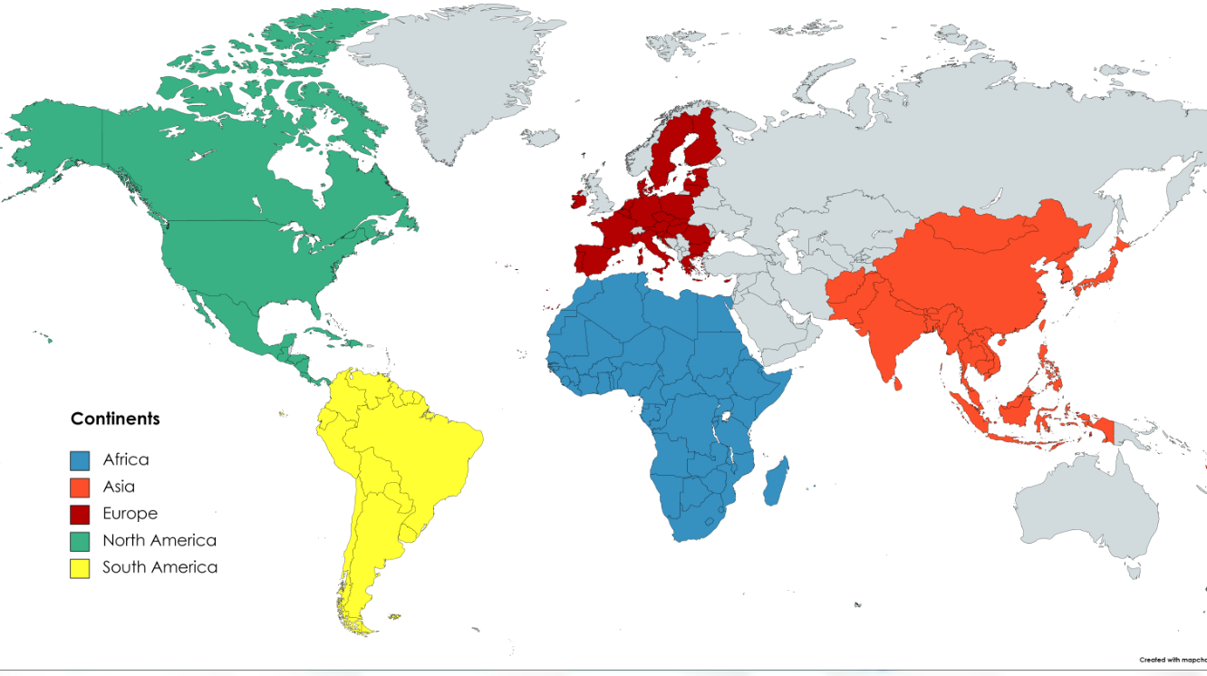



GROUPING VARIABLE:
CONTINENTS

Slide 17
GROUPING VARIABLE- Expanded
NORTH AMERICA | SOUTH AMERICA | ASIA | AFRICA | EUROPE
Mexico | Brazil | Japan | South Africa | Germany
Panama | Peru | Thailand | Egypt Arab Rep | Spain
El Salvador | Colombia | Vietnam | Tunisia | Netherlands
Costa Rica | Ecuador | Indonesia | Morocco | UK (United Kingdom)
Honduras | Chile | Malaysia | Kenya | Poland

Slide 18
VARIABLES

Slide 19
Primary education, pupils (numbers)
EDUCATION
Compulsory education, duration (years)
Primary school starting age (years)
Adjusted savings: education expenditure (% of GNI)

Slide 20
Current account balance (% of GDP)
ECONOMY
Adjusted net national income (annual % growth)
Gross savings (% of GDP)
Inflation, consumer prices (annual %)

Slide 21
Life expectancy at birth, total (years)
SOCIAL DEVELOPMENT
Adolescent fertility rate (births per 1,000 women ages 15-19)
Unemployment, female (% of female labor force) (modeled ILO estimate)
Unemployment, male (% of male labor force) (modeled ILO estimate)
Labor force participation rate, total (% of total population ages 15+) (modeled ILO estimate)

Slide 22
Survival to age 65, female (% of cohort)
Survival to age 65, male (% of cohort)
HEALTH
Prevalence of anemia among children (% of children under 5)
Prevalence of undernourishment (% of population)
Population ages 0-14 (% of total population)
Population ages 15-64 (% of total population)
Population ages 65 and above (% of total population)

Slide 23
HYPOTHESES TESTING

Slide 24
HYPOTHESIS #1
EDUCATION
Adjusted Savings: Education Expenditure (% of GNI)
SOCIAL
Unemployment, female (% of female labor)
Unemployment male (% of male labor)

Slide 25
HYPOTHESIS 1:
HYPOTHESIS: Adjusted savings: education expenditure (% of GNI) is negatively correlated with Unemployment female (% of female labor force) and Unemployment male (% of male labor force).
RATIONALE: The more expenditure on a country’s education, the increase in the number of people having access to education. As such, the more qualified people will become available for various jobs and the lower will be the unemployment levels for both male and female.

Slide 26
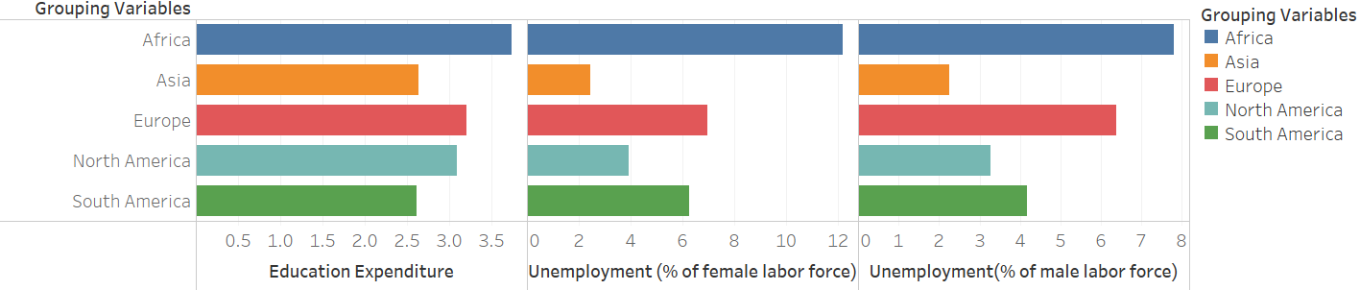
H1: Adjusted savings: education expenditure (% of GNI) is negatively correlated with Unemployment female (% of female labor force) and Unemployment male (% of male labor force).

Slide 27
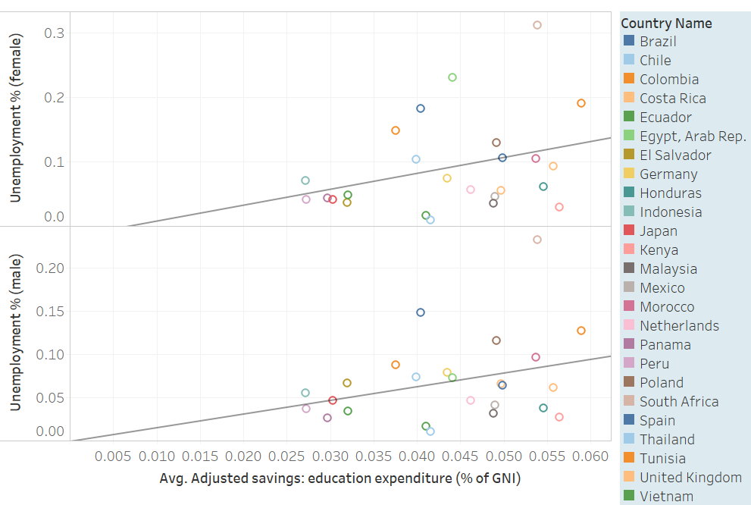
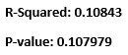
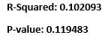
H1: Adjusted savings: education expenditure (% of GNI) is negatively correlated with Unemployment female (% of female labor force) and Unemployment male (% of male labor force).

Slide 28
RESULTS H1: Adjusted savings: education expenditure (% of GNI) is negatively correlated with Unemployment female (% of female labor force) and Unemployment male (% of male labor force).
Horizontal Bars:
Length of first far left Horizontal bars shows the average expenditure on education by the 5 analyzed Continents and the length of the following set of horizontal bars respectively show the female and male average unemployment rate in the continents. Color differentiates the continents from each other.
We can see that the African and European countries have the highest average education expenditure, yet they also have the highest average male and female unemployment. South American countries have the least average education expenditure and surprisingly also, they have the least average male and female unemployment. We expected a negative relationship between the two variables.
Scatter plot:
Scatter Plot also represents the same data set.
The trend lines show a positive relationship between the two variables and the color or the bubbles represent every individual country.
Conclusion:
The trend lines with P-values of 0.1079 and 0.1194 and low R-squared values of 0.1084 and 0.1020 for males and females respectively show that average education expenditure and average unemployment are related although not significantly, and that there are other unrecognized “factors” or variables causing the positive relationship.

Slide 29
HYPOTHESIS #2
HEALTH
2a: Survival to age 65, female (% of cohort) and Survival to age 65, male (% of cohort)
)
ECONOMY
Gross savings (% of GDP)
HEALTH
2b: Prevalence of anemia among children (% of children under 5) and Prevalence of undernourishment (% of population)

Slide 30
HYPOTHESIS 2:
Hypothesis-2a: Gross savings (% of GDP) is positively correlated with Survival to age 65, female (% of cohort) and Survival to age 65, male (% of cohort)
Hypothesis-2b: Gross savings (% of GDP) is negatively correlated with Prevalence of anemia among children (% of children under 5) and Prevalence of undernourishment (% of population)
RATIONALE: As the gross savings of a country increases, the people’s quality of life will be improved, food will be sufficient, and the level of medical attention will increase. This will decrease prevalence of anemia and prevalence of undernourishment. Also, the Survival to age 65 (% of cohort) will increase.

Slide 31
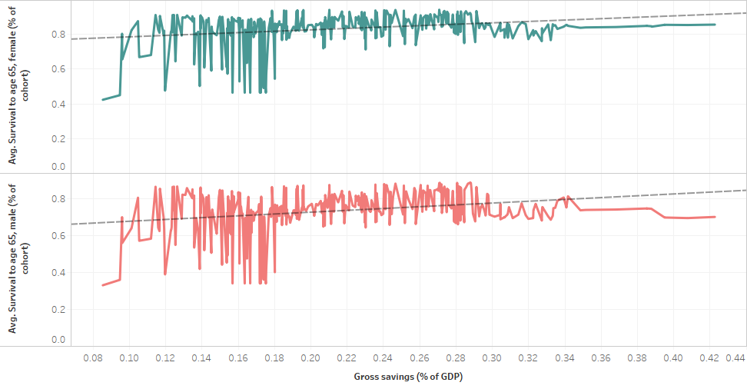
ANALYSIS 2A: Gross savings (% of GDP) is positively correlated with Survival to age 65, female (% of cohort) and Survival to age 65, male (% of cohort)
R-Squared: 0.0730622 P-Value: <0.0001
R-Squared: 0.08339 P-Value: <0.0001

Slide 32
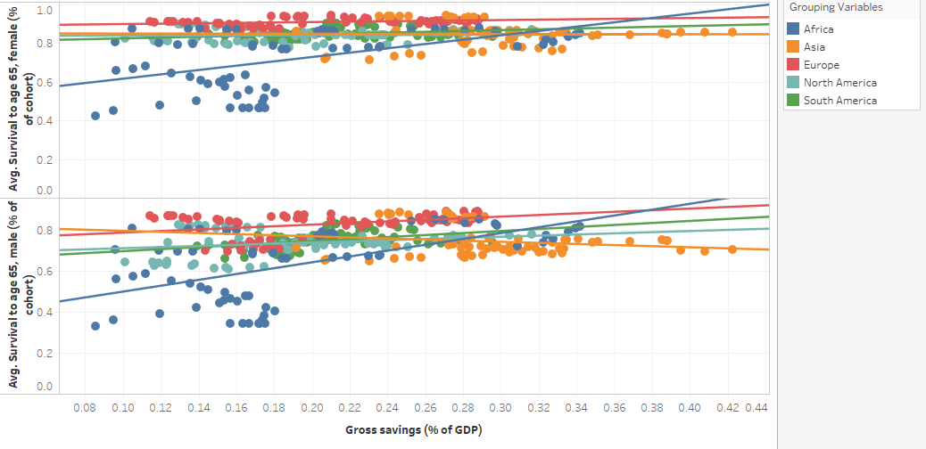
ANALYSIS 2A: Gross savings (% of GDP) is positively correlated with Survival to age 65, female (% of cohort) and Survival to age 65, male (% of cohort)
Female 65 (% of cohort Africa P=0.0001 Asia P=0.938561 Europe P=0.0094283 North America P=0.780457 South America P=0.0173121
Male 65 (% of cohort) Africa P=0.001 Asia P=0.141684 Europe P=0.0014364 North America P=0.0534924 South America P=0.001

Slide 33
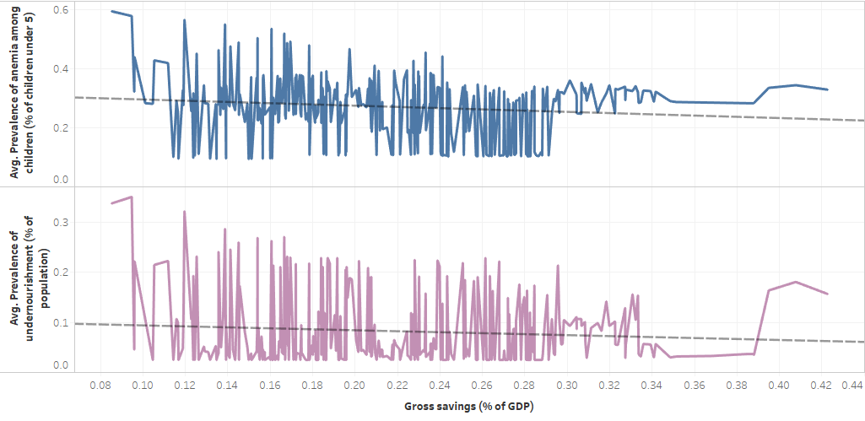
ANALYSIS 2B: Gross savings (% of GDP) is negatively correlated with Prevalence of anemia among children (% of children under 5) and Prevalence of undernourishment (% of population)
R-Squared: 0.0174961 P-Value: 0.0132628
R-Squared: 0.0081268 P-Value: 0.0921958

Slide 34
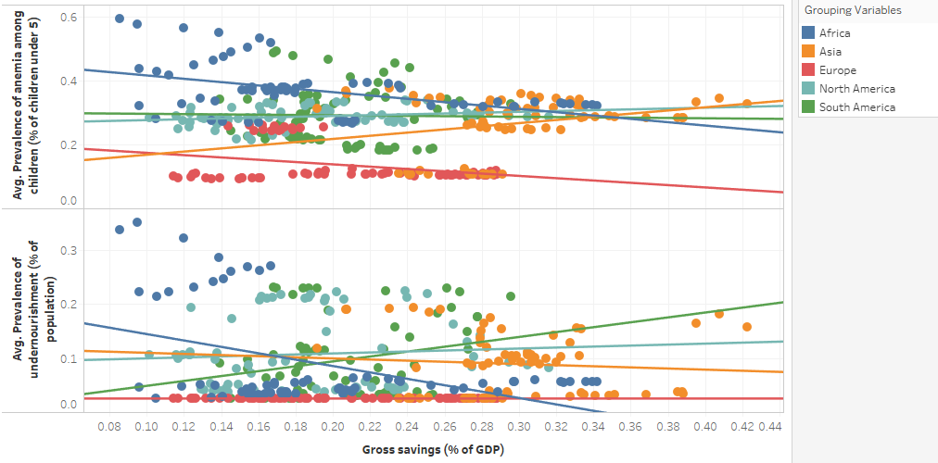
ANALYSIS 2B: Gross savings (% of GDP) is negatively correlated with Prevalence of anemia among children (% of children under 5) and Prevalence of undernourishment (% of population)
Anemia Africa P=0.0001659 Asia P=0.872648 Europe P=0.0052903 North America P=0.0426518 South America P=0.0229363
Undernourishment
Africa P=0.0001796 Asia P=0.482828 Europe P=N/A North America P=0.0426518 South America P=0.0522002

Slide 35
RESULTS H2A: Gross savings (% of GDP) is positively correlated with Survival to age 65, female (% of cohort) and Survival to age 65, male (% of cohort).
RESULTS H2B: Gross savings (% of GDP) is negatively correlated with Prevalence of anemia among children (% of children under 5) and Prevalence of undernourishment (% of population)
Line Chart:
The trend line with a p<0.0001 shows there is a significantly positive relationship between Gross savings and Survival to age 65, female.
The trend line with a p<0.0001 shows there is a significantly positive relationship between Gross savings and Survival to age 65, male.
The trend line with a p=0.013 shows there is a significantly negative relationship between Gross savings and Prevalence of anemia among children.
The trend line with a p=0.092 shows there is a significantly negative relationship between Gross savings and Prevalence of undernourishment.
Scatter plot:
The trend lines with a low p-value show there is a significantly positive relationship between Gross savings and Survival to age 65, female in Africa, Europe and South America.
The trend lines with a low p-value show there is a significantly positive relationship between Gross savings and Survival to age 65, male in 4 other continents except Asia.
The trend lines with a low p-value show there is a significantly negative relationship between Gross savings and Prevalence of anemia among children in Africa and Europe.
The trend line with a p=0.00018 shows there is a significantly negative relationship between Gross savings and Prevalence of undernourishment only in Africa.

Slide 36
RESULTS H2A: Gross savings (% of GDP) is positively correlated with Survival to age 65, female (% of cohort) and Survival to age 65, male (% of cohort).
RESULTS H2B: Gross savings (% of GDP) is negatively correlated with Prevalence of anemia among children (% of children under 5) and Prevalence of undernourishment (% of population)
Conclusion:
Based on the charts, we can conclude that there is a significantly positive correlation between Gross Savings (% of GDP) and Survival to age 65, male and female in most continents.
There is a significantly negative correlation between Gross savings (% of GDP) and Prevalence of anemia among children in Africa and Europe.
There is a significantly negative correlation between Gross savings (% of GDP) and Prevalence of Undernourishment only in Africa.

Slide 37
HYPOTHESIS #3
EDUCATION
Primary school starting age (years)
SOCIAL
Labor force participation rate, total (% of total population ages 15+) (modeled ILO estimate)

Slide 38
HYPOTHESIS 3:
HYPOTHESIS: Primary school starting age (years) is negatively correlated with Labor force participation rate, total (% of total population ages 15+) (modeled ILO estimate).
RATIONALE: Starting primary school earlier can boost both cognitive and non-cognitive skills easily. Confidence, problem-solving skills, coordination, self-esteem and social skills are the examples of the benefits that can be gained from school. If children cultivate these skills earlier, there will be more people in a country who can supply labor for the production of goods and services.

Slide 39
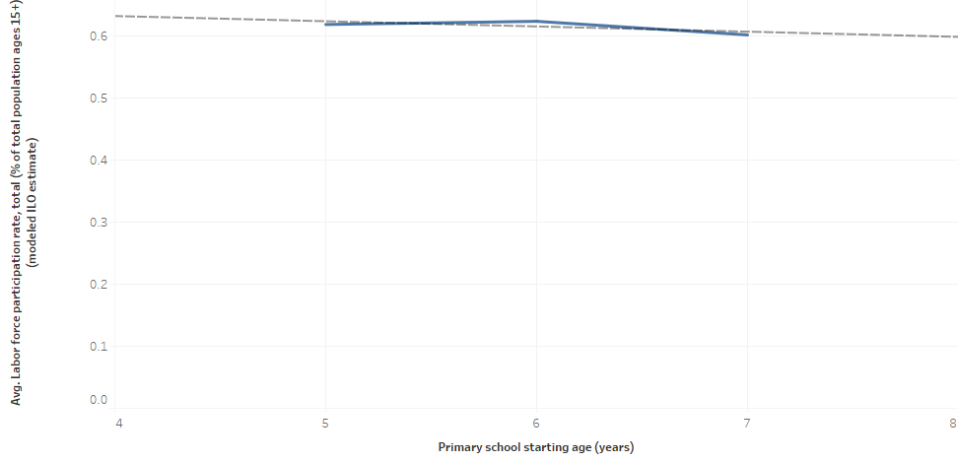
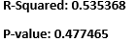
H3: Primary school starting age (years) is negatively correlated with Labor force participation rate, total (% of total population ages 15+) (modeled ILO estimate).

Slide 40
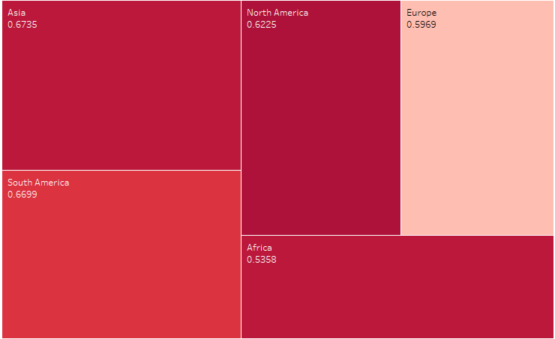
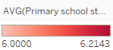
H3: Primary school starting age (years) is negatively correlated with Labor force participation rate, total (% of total population ages 15+) (modeled ILO estimate).

Slide 41
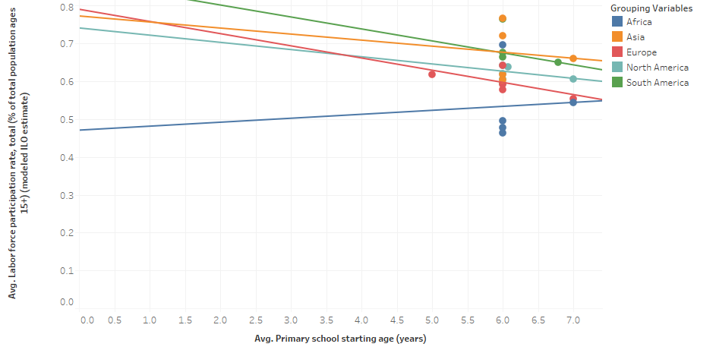
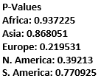
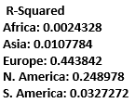
H3: Primary school starting age (years) is negatively correlated with Labor force participation rate, total (% of total population ages 15+) (modeled ILO estimate).

Slide 42
RESULTS H3: Primary school starting age (years) is negatively correlated with Labor force participation rate, total (% of total population ages 15+) (modeled ILO estimate).
Line Chart:
Little to no deviation between the 2 variables across the 25 countries within the 5 continents
Average force participation rate ranges between 60% to 62.5%
Primary school starting age (years) ranges between 5 years to 7 years
Trend Line: R- Squared= 0.54; P-Value= 0.48
Indicates a negative relationship between the Primary school starting age and Labor force participation rate
Barely any correlation between the 2 variables
Fairly high P-value, indicates that the null hypothesis is accepted therefore there is no significant relationship between the variables.
Tree Map:
Color shade indicates the average primary school starting age, and the numbers in the box represent the average labor force participation rate in decimal form.
Europe had the lowest primary school starting age but did not have the highest labor force participation rate (60%)
Asia had the highest labor force participation rate (67%) with a higher primary school starting age than Europe
North America had the highest Primary school starting age with a labor participation rate of 62%
Overall, all three observations go against our hypothesis

Slide 43
RESULTS H3: Primary school starting age (years) is negatively correlated with Labor force participation rate, total (% of total population ages 15+) (modeled ILO estimate).
Scatter Plot:
Africa’s trend line indicates a positive relationship between the 2 variables
R-Squared= 0.0024, P-Value= 0.94
Europe, North America, South America and Asia’s trend indicate a negative relationship between the two variables
Low R-Squared values indicate that a lot of the data has no correlation to the hypothesis
R- Squared range for these 4 continents: 0.44- 0.011. Europe was the highest indicating that this continent was closest to fitting the trend line model, however the R-Squared value still indicated that most of the data’s variation could not be explained.
Conclusion:
There is no significant relationship between the average labor force participation rate total (% of total population ages 15+) and the average primary school starting age (years)

Slide 44
HYPOTHESIS #4
EDUCATION
Compulsory education, duration (years)
SOCIAL
Adolescent fertility rate (births per 1,000 women ages 15-19)

Slide 45
HYPOTHESIS 4:
HYPOTHESIS: Compulsory education, duration (years) is negatively correlated to Adolescent fertility rate (births per 1,000 women ages 15-19)
RATIONALE: The more young women (15-19) stay in school, the more they will be educated about family planning and risks of pregnancies at a young age. This will lower births per 1,000 women ages 15-19.

Slide 46
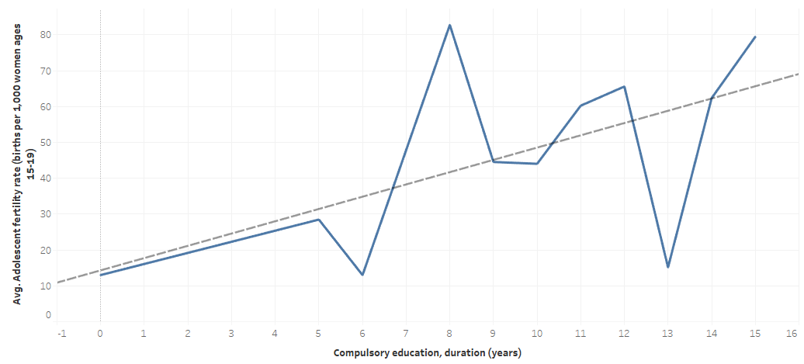
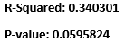
H4: Compulsory education, duration (years) is negatively correlated to Adolescent fertility rate (births per 1,000 women ages 15-19)

Slide 47
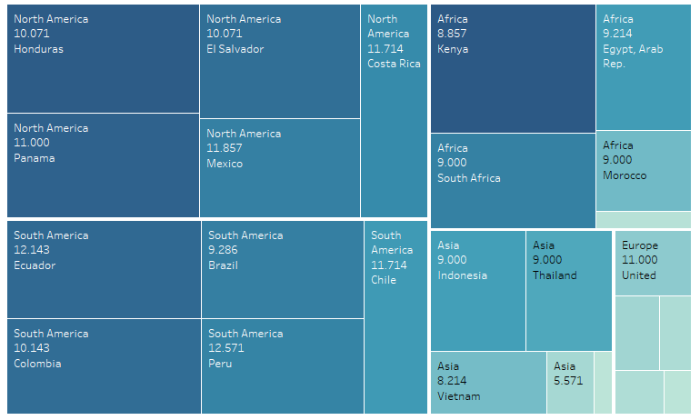
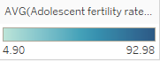
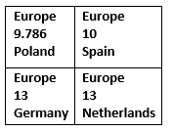
H4: Compulsory education, duration (years) is negatively correlated to Adolescent fertility rate (births per 1,000 women ages 15-19)

Slide 48
RESULTS H4: Compulsory education, duration (years) is negatively correlated to Adolescent fertility rate (births per 1,000 women ages 15-19)
Line Chart:
Compulsory education (years) ranged from 0 to 15 years
Big spike was seen for the compulsory education duration of 8 years which had the highest fertility rate births per 1000 women of 82.78
The lowest fertility rate births per 1000 women was 13, for a compulsory education duration of 6 years
A 13 year mandatory education duration saw a fairly low fertility rate of 15.16 in support of the hypothesis
This trend was counteracted by the higher fertility rates seen in longer duration years like 14 and 15 years
Trend line goes against the hypothesis showing a positive relationship between the 2 variables:
R-Squared is low at 0.34. This shows that 66% of the data’s variation cannot be explained
Tree Map:
Color shade represents the average adolescent fertility rate, while the figures in the boxes represent the average compulsory education duration in years for each country
The highest adolescent fertility rates were seen in North America and South America which had compulsory education years ranging between 10 - 12 years which does not support the hypothesis
Kenya stood out among the African countries for having the highest fertility rate in this region. Their average compulsory education duration is 8 years (lower end of spectrum), which supports the hypothesis
Europe had some of the lowest fertility rates, with longer duration years ranging between 9 to 13 years

Slide 49
RESULTS H4: Compulsory education, duration (years) is negatively correlated to Adolescent fertility rate (births per 1,000 women ages 15-19)
Conclusion:
Missing data for Malaysia (Asia) for its compulsory education duration for 2002
Major peaks in fertility rates per 1000 women were seen for compulsory years 8, 12 and 15
The greatest increase in fertility rates for consecutive years were seen between 13 and 14 years of education
Despite the few countries in Europe and one country in Africa that supported the hypothesis, no general trend was seen between the compulsory education duration (rates) and the adolescent fertility rate (births per 1,000 women ages 15-19)

Slide 50
HYPOTHESIS #5
EDUCATION
Compulsory education,duration (years)
HEALTH
Survival to age 65, female (% of cohort) and Survival to age 65, male (% of cohort)

Slide 51
HYPOTHESIS 5:
HYPOTHESIS: Compulsory education, duration (years) is positively correlated to Survival to age 65, female (% of cohort) and Survival to age 65, male (% of cohort).
RATIONALE: Males and Females in areas with more years of compulsory education will be more educated on healthy lifestyles such as nutrition, physical education, e.t.c. This in turn makes them survive longer.

Slide 52
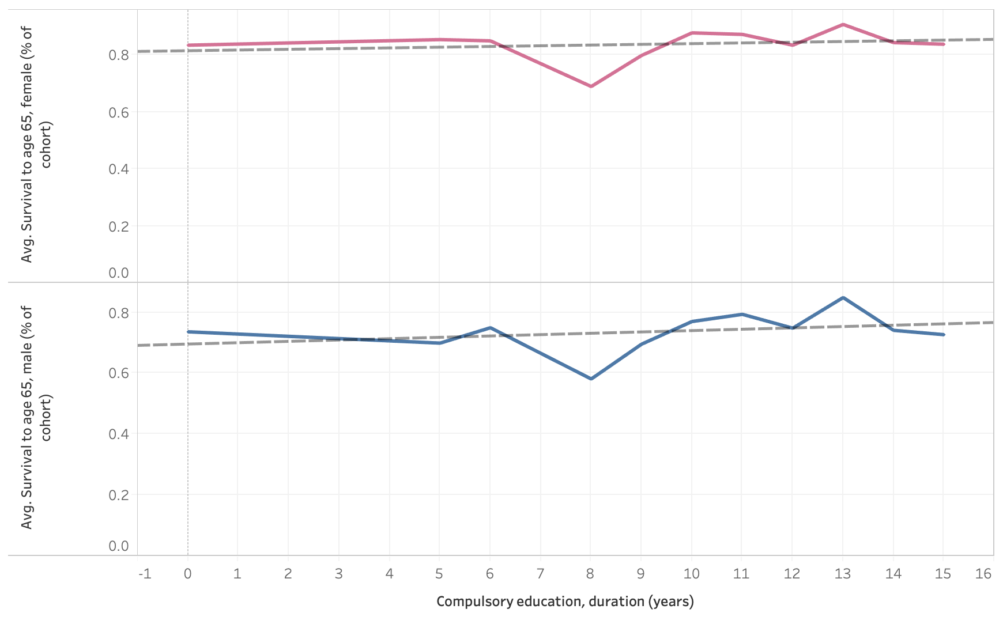
H5: Compulsory education, duration (years) is positively correlated to Survival to age 65, female (% of cohort) and Survival to age 65, male (% of cohort).
P-value: 0.56317
R-Squared: 0.03848
P-value: 0.38086
R-Squared: 0.08620

Slide 53
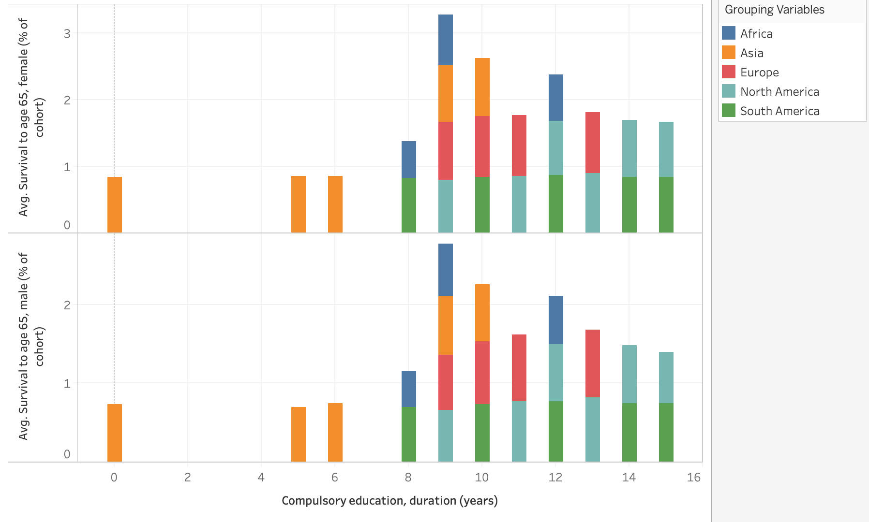
H5: Compulsory education, duration (years) is positively correlated to Survival to age 65, female (% of cohort) and Survival to age 65, male (% of cohort).

Slide 54
RESULTS H5: Compulsory education, duration (years) is positively correlated to Survival to age 65, female (% of cohort) and Survival to age 65, male (% of cohort).
Line Chart:
Compulsory education (years) ranged from 0 to 15 years
Downward dip in survival of both male and females with compulsory education till 8 years.
Compulsory education above 10 years shows slight increase in both male and female survival rate.
Trend line supports the hypothesis showing a positive relationship between the variables
R-square is 0.038 while P value is 0.563 for survival of female, and R-square is 0.086 while P-value is 0.380
Fairly high P-values depict that positive relationship is not significant.
Stacked Bars:
Compulsory education between 0-6 in asia survival rate is constant, ages 9+ show increase in survival rate.
South America shows constant survival age even with higher compulsory education.
Europe and North America show increase in survival rate between ages 12-15.
Africa shows highest survival rate at compulsory education of 9 years.
Conclusion:
Although there is positive relationship between compulsory education, duration (years) and the Survival to age 65, female (% of cohort) and Survival to age 65, male (% of cohort), it is insignificant.

Slide 55
HYPOTHESIS #6
EDUCATION
Primary education, pupils (numbers)
EDUCATION
Adjusted savings: education expenditure (% of GNI)

Slide 56
HYPOTHESIS 6:
HYPOTHESIS: Primary education, pupils (numbers) is positively correlated with Adjusted savings: education expenditure (% of GNI)
RATIONALE: As the number of primary education pupils increases, the number of primary schools will increase, and there will require more teachers. Thus, the wages and salaries that the country needs to spend on education will increase. This will increase adjusted savings: education expenditure (% of GNI).

Slide 57
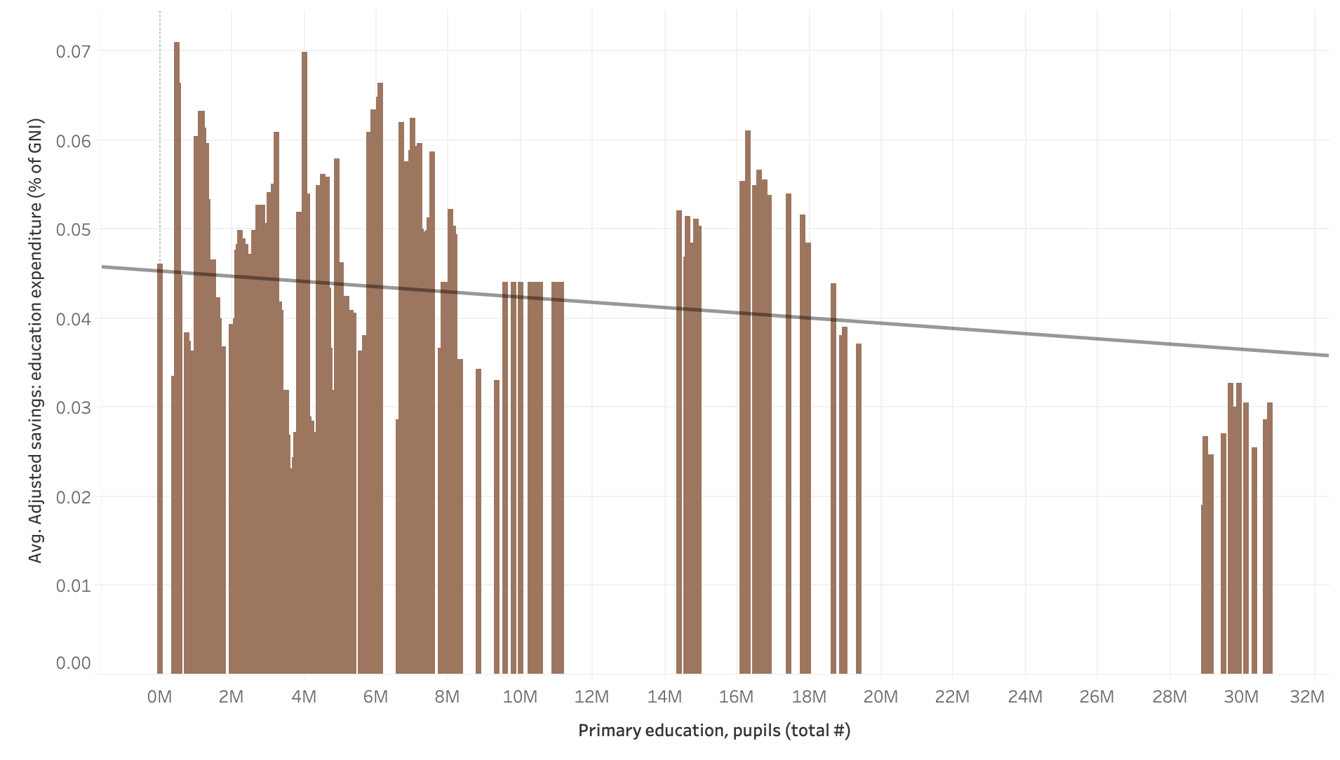
H6: Primary education, pupils (numbers) is positively correlated with Adjusted savings: education expenditure (% of GNI)
P-value: 0.00129
R-Squared: 0.03036

Slide 58
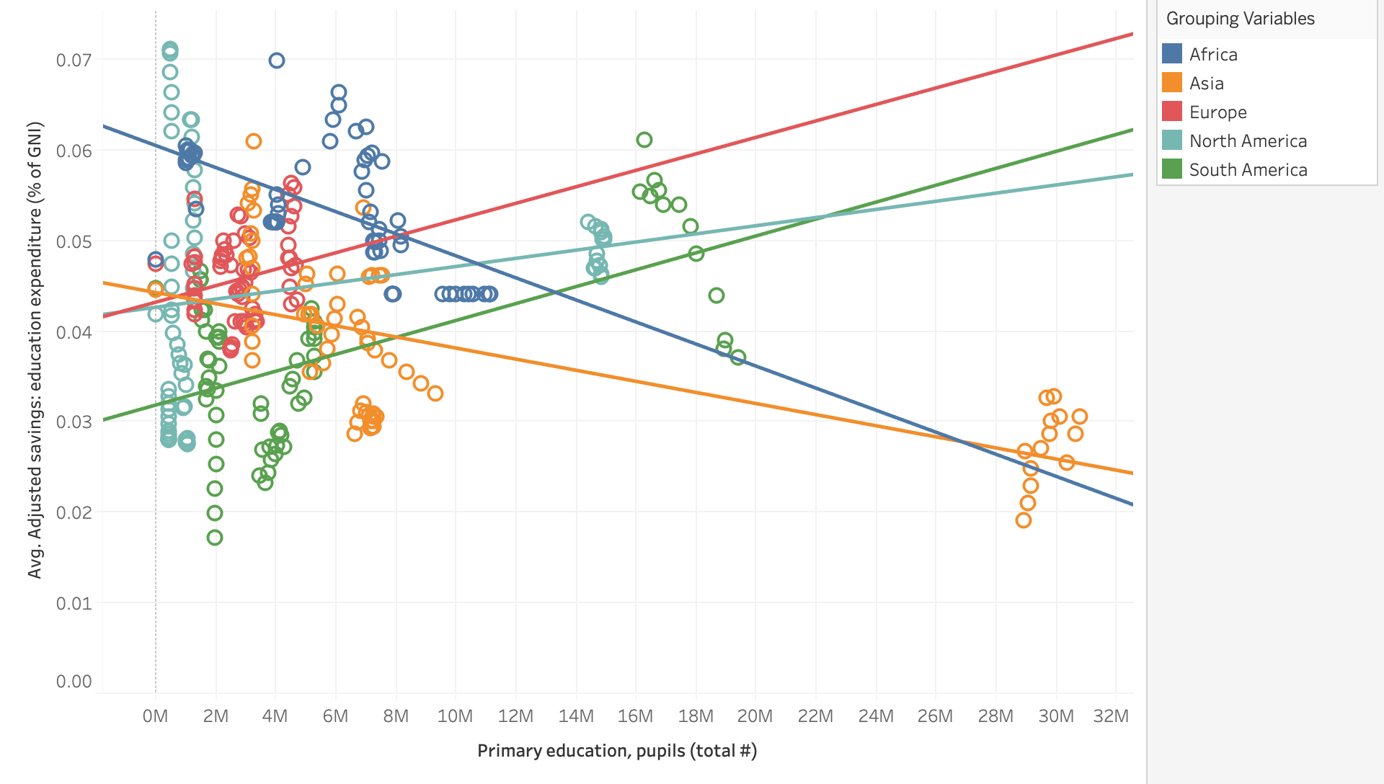
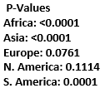
H6: Primary education, pupils (numbers) is positively correlated with Adjusted savings: education expenditure (% of GNI)
R-Squared
Africa: 0.345
Asia: 0.423
Europe: 0.046
N. America: 0.037
S. America 0.331

Slide 59
RESULTS H6: Primary education, pupils (numbers) is positively correlated with Adjusted savings: education expenditure (% of GNI)
Bar Graph:
Primary education, pupils (total #) ranged from 0 to 31 million
Primary education pupils ranging from 0m - 6m had a larger increase in education expenditure.
With the total # of pupils above 20m+ we see there is a decrease in adjusted savings.
Trend Line does not support the hypothesis showing a negative relationship between 2 the variables
R-squared is 0.030 while P-value is 0.001
Scatter Plot:
Education expenditures are higher in North America and Africa when primary education total is between 0m-3m
Europe, North America and South America’s trend line indicates a positive relationship between the 2 variables, with respective r-squares and p-values
R-Squared= 0.046, P-Value= 0.076, R-Squared= 0.03, P-Value= 0.11, R-Squared= 0.033, P-Value= 0.0001,
Africa and Asia’s trend indicate a negative relationship between the two variables
However, low R-Squared values indicate that a lot of the data has no correlation to each other and therefore the hypothesis
Conclusion:
Overall, there is no significant relationship between the primary education, pupils (total #) and the Adjusted savings: education expenditure (% of GNI)

Slide 60
HYPOTHESIS #7
SOCIAL
Labor force participation rate, total (% of total population ages 15+) (modeled ILO estimate)
EDUCATION
Primary education, pupils (numbers)
ECONOMY
Gross savings (% of GDP)

Slide 61
HYPOTHESIS 7:
HYPOTHESIS: Primary education, pupils (numbers) is positively correlated with Labor force participation rate, total (% of total population ages 15+) (modeled ILO estimate) and Gross savings (% of GDP).
RATIONALE: As the number of primary education pupils increases, educated workers will increase. (Even if they only graduated from primary school and did not attend a higher level school.) A country's economy becomes more productive as the proportion of educated workers increases since educated workers can more efficiently carry out tasks that require literacy and critical thinking. Also, there will be more people who can supply labor for the production of goods and services.

Slide 62
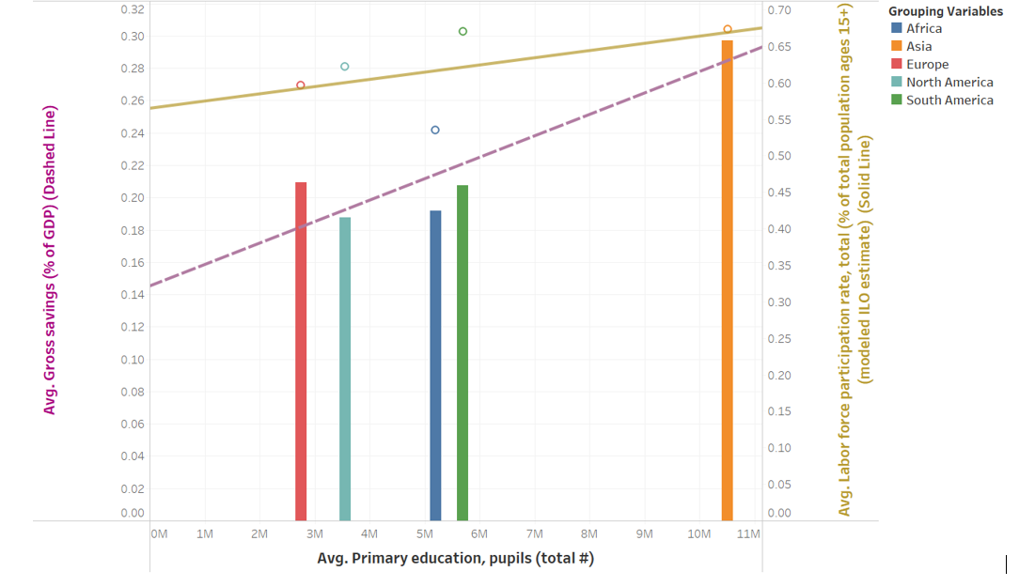
H7: Primary education, pupils (numbers) is positively correlated with Labor force participation rate, total (% of total population ages 15+) (modeled ILO estimate) and Gross savings (% of GDP).

Slide 63
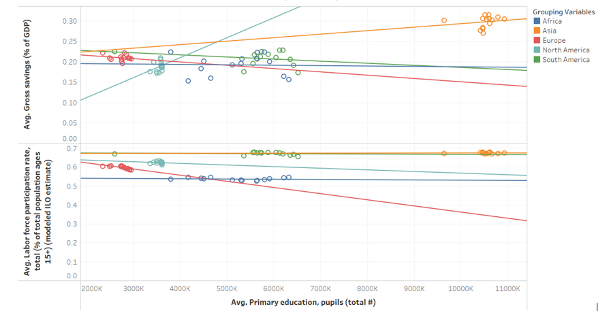
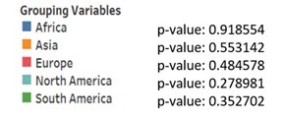
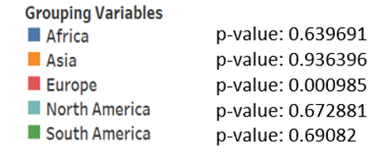
H7: Primary education, pupils (numbers) is positively correlated with Labor force participation rate, total (% of total population ages 15+) (modeled ILO estimate) and Gross savings (% of GDP).

Slide 64
RESULTS H7: Primary education, pupils (numbers) is positively correlated with Labor force participation rate, total (% of total population ages 15+) (modeled ILO estimate) and Gross savings (% of GDP).
Scatter Plot:
Average of Primary education, pupils (total #) ranged from 2.3 m to 11m
Average of Gross savings (% of GDP) ranged from 15% to 31%
Average of Labor force participation rate, total (% of total population ages 15+) (modeled ILO estimate) ranged from 53% to 68%
The trend line graph of Primary education, pupils vs Gross savings shows statistically a positive relationship in North America and Asia and a negative relationship in the other 3 continents.
The trend line graph of Primary education, pupils vs Labor force shows statistically a positive relationship only in Asia and a negative relationship in the other 4 continents

Slide 65
RESULTS H7: Primary education, pupils (numbers) is positively correlated with Labor force participation rate, total (% of total population ages 15+) (modeled ILO estimate) and Gross savings (% of GDP).
Bar Chart:
The trend line of Primary education, pupils vs Gross savings (aggregated model) shows that when Primary education, pupils increases the Gross savings increases.
The trend line with a p<0.04 confirms there is a significant relationship between Primary education, pupils, and Gross savings.
The trend line of Primary education, pupils vs Labor force participation rate, total, shows that when Primary education, pupils increases the Labor force increases.
The trend line with a p>0.36 confirms there is no significant relationship between Primary education, pupils and Labor force.
Conclusion:
Missing data for Primary education for the following countries and years:
Egypt for 2008 and 2015; Kenya for 2010 – 2013; Thailand for 2003; Netherlands for 2013 and 2014; Poland for 2015; Costa Rica for 2003; Honduras for 2002; Brazil for 2006; Columbia for 2003
There is a statistically positive relationship between Primary education, pupils and Gross savings in North America and Asia.
There is a statistically positive relationship between Primary education, pupils and Labor force only in Asia.

Slide 66
HYPOTHESIS #8
EDUCATION
Adjusted savings: education expenditure (% of GNI)
ECONOMY
Current account balance (% of GDP)

Slide 67
HYPOTHESIS 8:
HYPOTHESIS: Adjusted savings: education expenditure (% GNI) is positively correlated with Current account balance (% of GDP).
RATIONALE: The current account balance is the sum of net exports of goods and services, net primary income, and net secondary income. (World Bank, 2021) The more expenditure on education can show that a country attaches more importance to education. Education enriches people’s understanding of themselves and the world. Education raises people’s productivity, creativity and promotes entrepreneurship and technological advances. In addition, education plays a very crucial role in securing economic and social progress and improving income distribution, all of which contributes to a better current account balance (% of GDP).

Slide 68
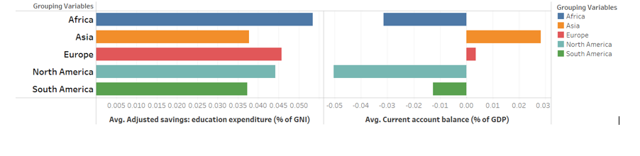
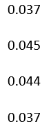
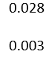
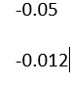
H8: Adjusted savings: education expenditure (% GNI) is positively correlated with Current account balance (% of GDP).

Slide 69
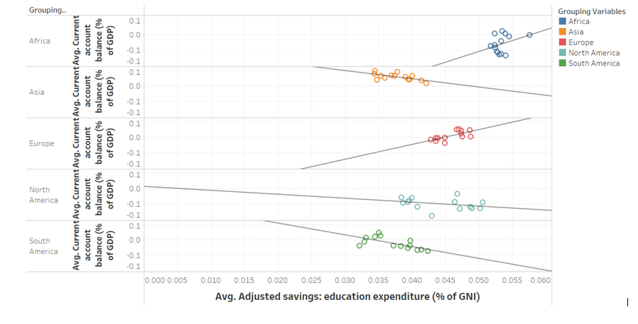
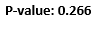
H8: Adjusted savings: education expenditure (% GNI) is positively correlated with Current account balance (% of GDP).

Slide 70
RESULTS H8: Adjusted savings: education expenditure (% GNI) is positively correlated with Current account balance (% of GDP).
Horizontal Bar Chart:
Length of left Horizontal bars shows the average expenditure on education by the 5 Continents and the length of right Horizontal bars shows the 5 continents' average current account balance. Color differentiates the continents from each other.
Africa and Europe have the highest average education expenditure, Asia has a high average current account balance and North America has the lowest average current account balance at -5%.
Scatter Plot:
Adjusted savings: education expenditure (% GNI) ranged from 3.2% to 5.8%Adjusted savings: education expenditure (% GNI) ranged from 3.2% to 5.8%
Current account balance (% of GDP) ranged from -8.9% to 4.8%
The trend line graph indicates a positive relationship between the Adjusted savings: education expenditure vs Current account balance for Africa and Europe but the trend line of Africa has a high p-value of 0.22.
So, the trend line graph of Adjusted savings: education expenditure vs Current account balance confirms a significantly positive relationship only in Europe and a negative relationship in the other 4 continents.
Conclusion:
There is a significantly positive relationship between the Adjusted savings: education expenditure and Current account balance only in Europe.

Slide 71
HYPOTHESIS #9
HEALTH
Prevalence of anemia among children (% of children under 5)
EDUCATION
Primary school starting age (years)

Slide 72
HYPOTHESIS 9:
HYPOTHESIS: Prevalence of anemia among children (% of children under 5) is positively correlated with Primary school starting age (years).
RATIONALE: Anemia continues to become a major public health problem in some countries particularly among younger children as they are more vulnerable to this sickness and its consequences. Thus, when the prevalence of anemia among children is increased, the primary school starting age will also increase as children are then forced to start primary school at a later age due to the illness.

Slide 73
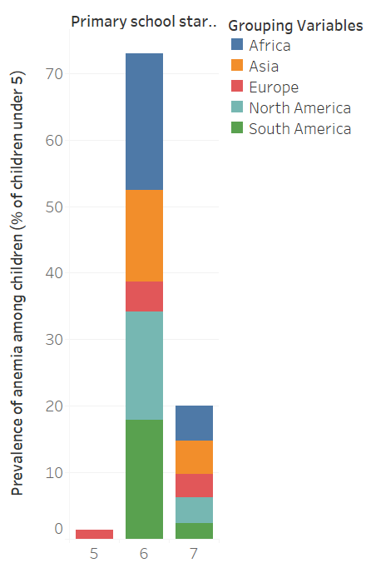
H9: Prevalence of anemia among children (% of children under 5) is positively correlated with Primary school starting age (years).

Slide 74
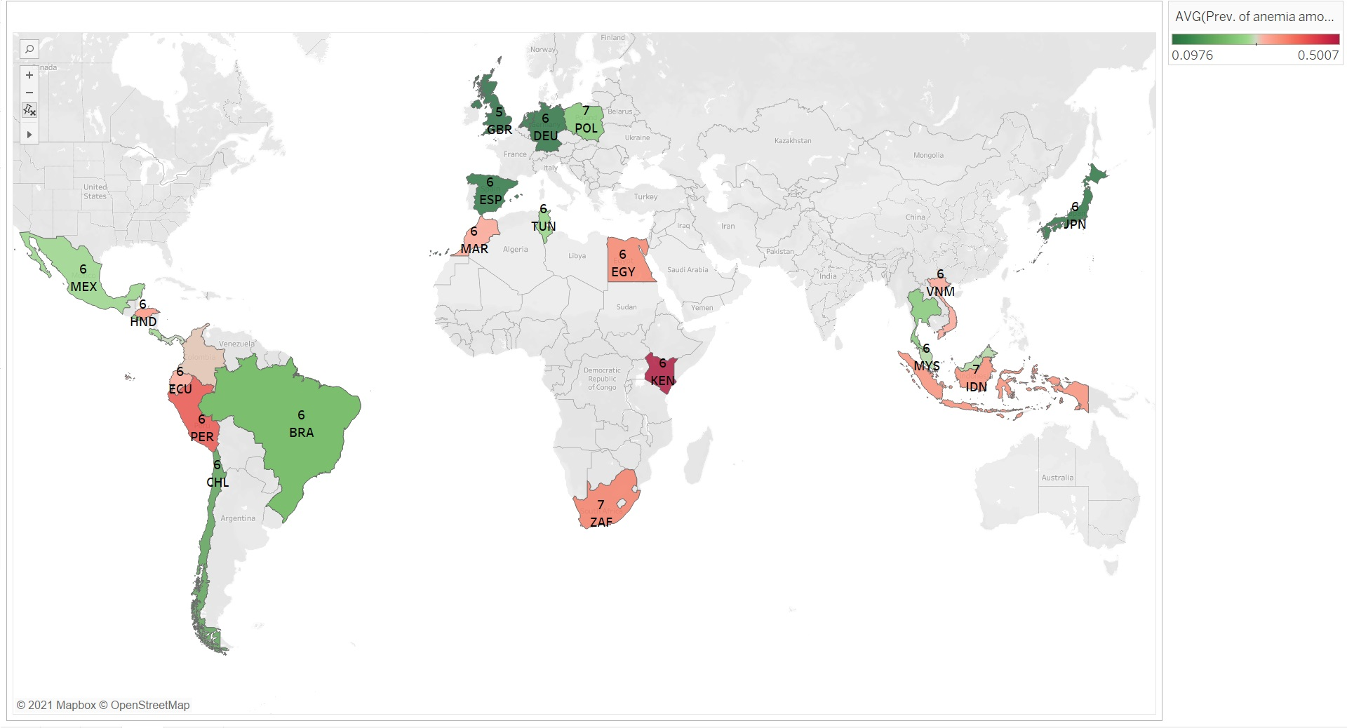
H9: Prevalence of anemia among children (% of children under 5) is positively correlated with Primary school starting age (years).

Slide 75
RESULTS H9: Prevalence of anemia among children (% of children under 5) is positively correlated with Primary school starting age (years).
Horizontal Bars:
Most of the continents in our analysis have a starting age of 6 regardless of the rate of prevalence of anaemia among children under 5
Only Europe (red) has countries that have a starting age of 5 and it has the lowest rate of prevalence of anaemia among all the continents we analyzed
Symbol Map:
World map shows countries color coordinated in a way that the darker the green, the lower the average prevalence of anaemia among children under 5 years; The darker the red, the higher the prevalence of anaemia among children under 5 years in those countries.
Kenya has the highest average prevalence of anemia (0.5007) among children under the age of 5. United Kingdom has the least average prevalence of anemia among children under 5 (0.0976).
Kenya is one of the countries tied with the highest Primary School starting age (7) and Great Britain is one of the countries tied with the lowest Primary School starting age (5).
This pattern however is not uniformed in all countries. For example, Japan has a very low prevalence of anemia (0.1098) represented by a dark green color yet, it has the same Primary School starting age (6) as Kenya, Peru and Egypt to name a few. These three countries all happen to have a red color indicating they have a higher prevalence of anemia among children under 5.
Conclusion:
The prevalence of anemia in children under 5 has no effect on Primary School starting age in the current countries analyzed because a good number countries with low and high anaemia rates have the same primary school starting age

Slide 76
HYPOTHESIS #10
ECONOMY
Inflation, consumer prices (annual %)
SOCIAL
Unemployment, female (% of female labor)
Unemployment male (% of male labor)
HEALTH
Population ages 15-64 (% of total population)

Slide 77
HYPOTHESIS 10:
HYPOTHESIS-10a: Inflation, consumer prices (annual %) is positively correlated with Unemployment, female (% of female labor force) and Unemployment, male (% of male labor force).
HYPOTHESIS-10b: Population ages 15-64 (% of total population) is positively correlated with Unemployment, female (% of female labor force) and Unemployment, male (% of male labor force).
RATIONALE: 1. A high inflation rate can hurt the economy. Since everything costs more, manufacturers produce less and may be forced to lay off workers. 2. The more the population ages 15-64 increase, the more available labor a country has. This makes the labor market more competitive, which will result in it being difficult for people to find jobs, which will thus lead to an increase in the unemployment rate.

Slide 78
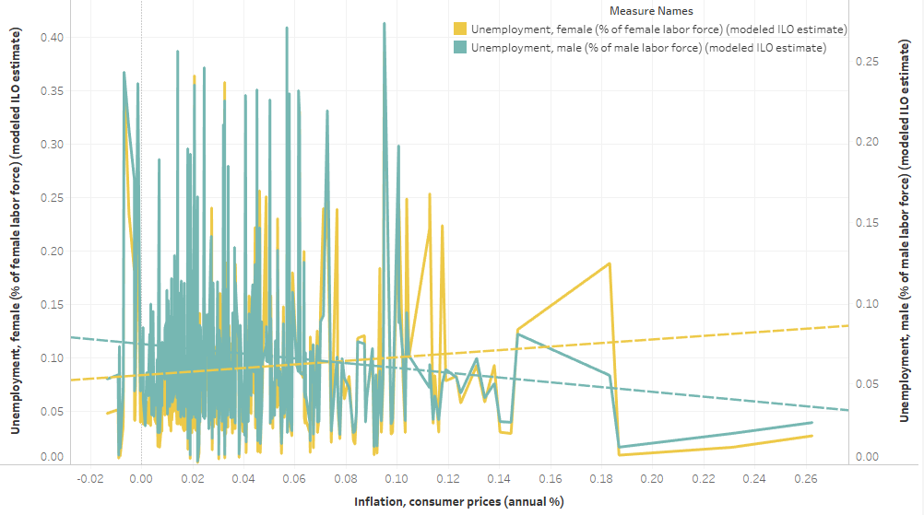
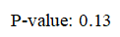
H10a: Inflation, consumer prices (annual %) is positively correlated with Unemployment, female (% of female labor force) and Unemployment, male (% of male labor force).

Slide 79
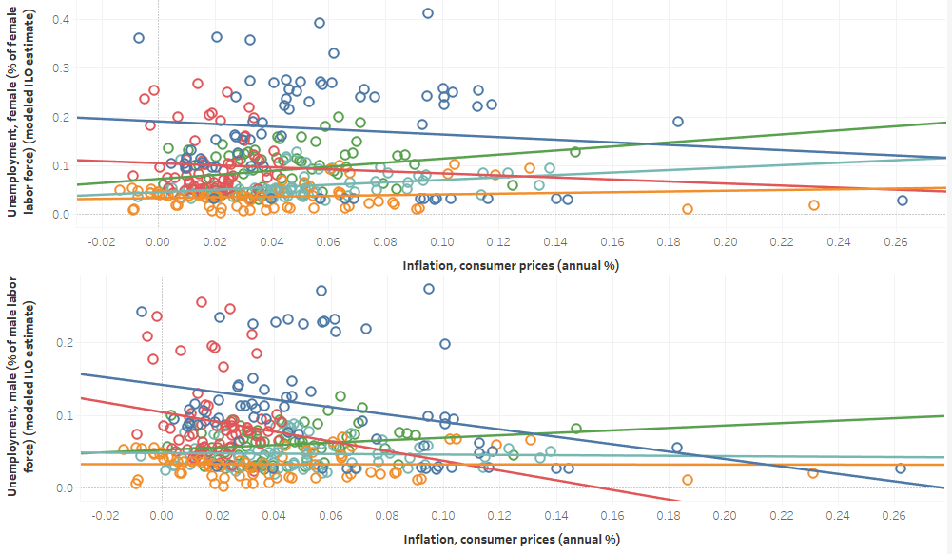
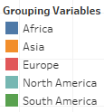
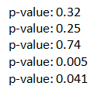
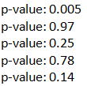
H10a: Inflation, consumer prices (annual %) is positively correlated with Unemployment, female (% of female labor force) and Unemployment, male (% of male labor force).

Slide 80
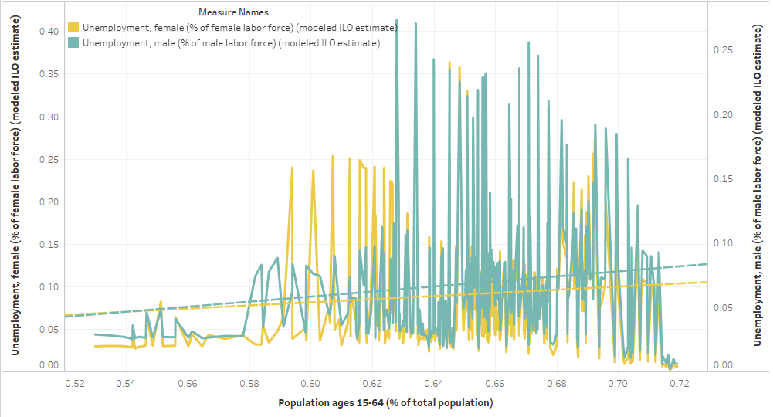
H10b: Population ages 15-64 (% of total population) is positively correlated with Unemployment, female (% of female labor force) and Unemployment, male (% of male labor force).

Slide 81
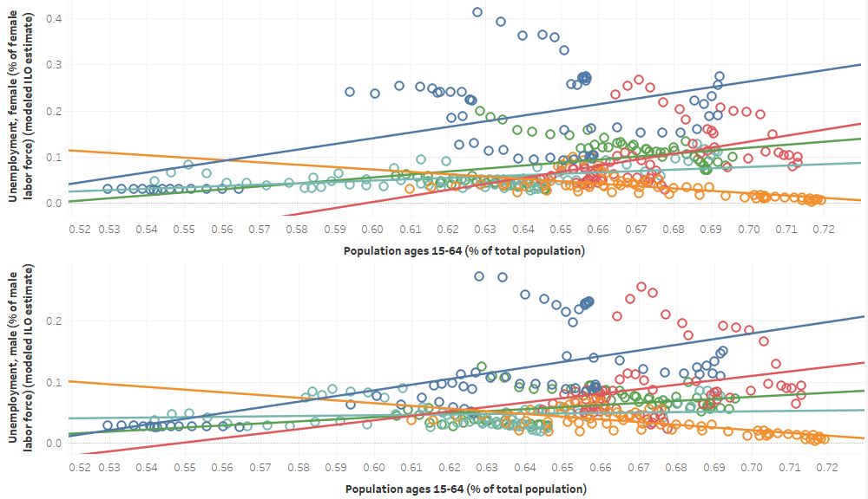
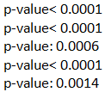
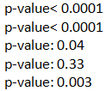
H10b: Population ages 15-64 (% of total population) is positively correlated with Unemployment, female (% of female labor force) and Unemployment, male (% of male labor force).

Slide 82
RESULTS H10a: Inflation, consumer prices (annual %) is positively correlated with Unemployment, female (% of female labor force) and Unemployment, male (% of male labor force).
H10b: Population ages 15-64 (% of total population) is positively correlated with Unemployment, female (% of female labor force) and Unemployment, male (% of male labor force).
Data available for all countries and years we chose.
Dual Line Chart: When combined with 5 Continents data,
the trend line of Inflation VS Unemployment(male) shows that when Inflation increases, the Unemployment(male) decreases; and the trend line of Inflation VS Unemployment(female) shows a positive relationship but with a high p-value of 0.13. Thus, there is not a significantly positive association between Inflation and Unemployment(female/male).
the trend line of Population ages 15-64 VS Unemployment(female) and the trend line of Population ages 15-64 VS Unemployment(male) show that when Population ages 15-64 increases, the Unemployment (female&male) increases. And, the trend line with a p-value of 0.08 and the trend line with a p-value of 0.006 confirm the above observation that there is a significantly positive association between Population ages 15-64 and Unemployment (female/male), although the correlation coefficients are small.

Slide 83
RESULTS H10a: Inflation, consumer prices (annual %) is positively correlated with Unemployment, female (% of female labor force) and Unemployment, male (% of male labor force).
H10b: Population ages 15-64 (% of total population) is positively correlated with Unemployment, female (% of female labor force) and Unemployment, male (% of male labor force).
Scatter Plot:
The trend lines of Inflation VS Unemployment(female) with p-values of 0.0005 and 0.041 show a significantly positive relationship between Inflation and Unemployment(female) only in North America and South America but a negative relationship in Africa and Europe.
The trend lines graph of Inflation VS Unemployment(male) shows a negative relationships between Inflation and Unemployment(male) in North America, Africa, Asia and Europe; and shows a positive relationship in South America, but the trend line of South America has a high p-value of 0.13. Thus, Inflation has no significantly positive impact on Unemployment(male) in the 5 Continents we chose.
The trend lines of Population ages 15-64 VS Unemployment(female) with a low p-value show that except Asia, the Population ages 15-64 has significantly positive impact on Unemployment(female) in the Continents we chose.
The trend lines of Population ages 15-64 VS Unemployment(male)with a low p-value show that Population ages 15-64 has significantly positive impact on Unemployment(male) in Africa, Europe and South America.

Slide 84
RESULTS H10a: Inflation, consumer prices (annual %) is positively correlated with Unemployment, female (% of female labor force) and Unemployment, male (% of male labor force).
H10b: Population ages 15-64 (% of total population) is positively correlated with Unemployment, female (% of female labor force) and Unemployment, male (% of male labor force).
Conclusion:
There is no significant relationship between the Inflation(consumer prices) and Unemployment of (female&male).
There is a significantly positive correlation between Population ages 15-64 and Unemployment of (female&male).

Slide 85
SUMMARIZED KEY RESULTS

Slide 86
SUMMARIZED KEY RESULTS
Based on our data:
➔ Heavy investment into a country’s education sector does not guarantee less unemployment levels for its population.
➔ A country’s investment in education can contribute to its economic development. Thus, countries should increase investing in education as that has the potential of increasing their current account balance.
➔ Normal assumption is that a country with a longer compulsory education duration will have a lower adolescent fertility rate, however this is false as the relationship between these 2 variables is insignificant.
➔ Primary school starting age has no major impact on a country’s Economy, Health sector, or its Social Development.
➔ Growing economies are associated with longer and healthier lives. The increase in gross savings of a country has shown to reduce the rates of undernourishment for countries in Africa.

Slide 87
04
SCOPE & LIMITATIONS

Slide 88
SCOPE AND LIMITATIONS
Scope:
The purpose of this study was to analyze and compare how Education influences each of the following aspects:
Economy
Social Development
Health
The time period of this study was from the years 2002 through 2015.
The topics covered in this study was whether Education had a significant relationship between the various variables, Economy, Social Development and Health.
The geographical location covered in this study were as follows:
5 countries in Asia (Japan, Thailand, Vietnam, Indonesia, and Malaysia)
5 countries in Africa (South Africa, Egypt Arab Republic, Tunisia, Morocco, and Kenya)
5 countries in Europe (Germany, Spain, Netherlands, United Kingdom, and Poland)
5 countries in North America (Mexico, Panama, El Salvador, Costa Rica, and Honduras)
5 countries in South America (Brazil, Peru, Colombia, Ecuador, and Chile)

Slide 89
SCOPE AND LIMITATIONS
· Limitations:
Only 5 countries per continent were analyzed so, conclusions drawn may not represent the other countries that were not analyzed.
Data only represents 14 years of data from 2002 to 2015. As such, the relationships and trends presented could be different for years prior to 2002 and years after 2015.
Missing data for Compulsory education for the following countries and years:
Malaysia for 2002
Missing data for Primary education for the following countries and years:
Egypt for 2008 and 2015; Kenya for 2010 – 2013; Thailand for 2003; Netherlands for 2013 and 2014; Poland for 2015; Costa Rica for 2003; Honduras for 2002; Brazil for 2006; Columbia for 2003

Slide 90
05
CONCLUSIONS & FUTURE RESEARCH

Slide 91
CONCLUSIONS AND FUTURE RESEARCH
Build upon findings:
Expand the number of countries studied per continent to 15 or more in order to have a more representative sample
Expand the time period studied to 15-20+ years
Explore more variables within each category:
Some variables such as primary school starting age as an example are inconclusive; other causal factors/variables need to be included in the regression in order to have a more complete conclusion of the hypotheses.
Explore new categories as Education may have a greater impact on them than those explored in this study:
Examples of these categories can be Technology and Innovation or the Environment as these both influence a country’s development to a great extent. Studying how access to or a lack of access to Education impacts such categories, can be of great insight to a country’s decision making process.

Slide 92
CONCLUSIONS AND FUTURE RESEARCH
Analyze more recent data to understand how over time education requirements have evolved. This in turn may provide more context of their impact on developmental factors such as those explored in this study.

Slide 93
06
REFERENCES

Slide 94
REFERENCES
(n.d.). Retrieved from Collins: https://www.collinsdictionary.com/dictionary/english/economy
(n.d.). Retrieved from Encylopedia.com: https://www.encyclopedia.com/science/encyclopedias-almanacs-transcripts-and-maps/healthcare-systems
(2008 - 2009). Retrieved from New Brunswick Canada: https://www2.gnb.ca/content/gnb/en/departments/esic/overview/content/what_is_social_development.html
(2020, January 20). Retrieved from Habitat for Humanity of Broward: https://www.habitatbroward.org/benefits-of-education/#:~:text=It%20helps%20people%20become%20better,rights%2C%20laws%2C%20and%20regulations.
(2021, March 19). Retrieved from The World Bank: https://www.worldbank.org/en/topic/socialsustainability/overview
Bansal, R. (2020, January 4). Retrieved from The Times of India: https://timesofindia.indiatimes.com/blogs/voices/is-education-the-most-important-step-in-the-development-of-the-country/

Slide 95
REFERENCES (cont…)
Felman, A. (2017, July 31). What is good health? Medicalnewstoday. https://www.medicalnewstoday.com/articles/150999#what_is_health
Grant, C. (2017, March 3). K4D. Retrieved from Helpdesk Report: https://assets.publishing.service.gov.uk/media/5b9b87f340f0b67896977bae/K4D_HDR_The_Contribution_of_Education_to_Economic_Growth_Final.pdf
"Healthcare Systems ." Encyclopedia of Bioethics. . Retrieved March 18, 2021 from Encyclopedia.com: https://www.encyclopedia.com/science/encyclopedias-almanacs-transcripts-and-maps/healthcare-systems
Manstead, A. (2014, July). Retrieved from Economic and Social Research Council: https://esrc.ukri.org/news-events-and-publications/evidence-briefings/the-wellbeing-effect-of-education/
King, E. (2011, January 1). Retrieved from World Bank Blogs: https://blogs.worldbank.org/education/education-is-fundamental-to-development-and-growth

Slide 96
REFERENCES (cont…)
Picker, L. (2007, March). Retrieved from National Bureau of Economic Research: https://www.nber.org/digest/mar07/effects-education-health
Raghupathi, V., Raghupathi, W. The influence of education on health: an empirical assessment of OECD countries for the period 1995–2015. Arch Public Health 78, 20 (2020). https://doi.org/10.1186/s13690-020-00402-5
Radcliffe, B. (2020, August 19). Retrieved from Investopedia: https://www.investopedia.com/articles/economics/09/education-training-advantages.asp
Spiel, C. S. (2018). The Contribution of Education to Social Progress. In M. Schweisfurth, International Panel on Social Progress (pp. 753-778). Cambridge: Cambridge University Press.

Slide 97
THANK YOU!

Slide 98


